Slide 1


Student Grade System
Tracking and managing student grades is a critical component of modern education. An effective student grade system provides educators with the tools to accurately assess student performance, identify areas for improvement, and communicate progress to students and parents. This system serves as the foundation for data-driven decision making, enabling schools to tailor their curriculum and instruction to meet the unique needs of each student.
At the heart of the student grade system is a comprehensive database that stores and organizes all relevant student information, from assignment scores and test results to attendance records and behavioral data. By centralizing this data, educators can quickly access and analyze student performance, identify trends, and pinpoint areas where students may be struggling. This information can then be used to develop targeted interventions and personalized learning plans, ensuring that each student has the support they need to succeed.
PRESENT BY:- AKASH SURESH SULTANE
PARTNER:- SOHAN MANOJ WAYKOS

Slide 2
Overview
Student-Centric Approach
Holistic Evaluation
The student grade system is designed with a strong focus on the individual student. It provides a comprehensive platform to track and manage each student's academic progress, allowing teachers and administrators to tailor their support and guidance to meet the unique needs of every learner. By placing the student at the center of the system, the goal is to foster a nurturing and empowering environment that enables students to reach their full potential.
The grade system goes beyond just numerical scores, incorporating a multifaceted approach to student assessment. It considers not only academic performance but also factors such as class participation, project work, and extracurricular involvement. This holistic evaluation provides a well-rounded understanding of each student's strengths, weaknesses, and overall academic growth, allowing for more informed decision-making and targeted interventions.
Transparent Reporting
Data-Driven Insights
The system leverages data-driven analytics to identify patterns, trends, and areas of concern. This data-driven approach enables administrators and educators to make informed decisions, allocate resources effectively, and implement targeted interventions. By harnessing the power of data, the student grade system can help identify and address the unique needs of each student, ultimately leading to improved academic outcomes and student success.
Transparency is a key tenet of the student grade system. Parents, students, and teachers have access to detailed reports and analytics that clearly communicate academic progress, areas for improvement, and overall performance trends. This open communication fosters a collaborative environment where all stakeholders can work together to support the student's educational journey.

Slide 3
Student Registration
The student registration process is a crucial step in the student grade system. This is where new students enroll and provide their personal information, academic history, and other relevant details that will be used to create their profile and academic record within the system.
During the registration process, students will be required to fill out a comprehensive form that covers various aspects, such as their full name, date of birth, contact information, emergency contacts, and any special needs or accommodations they may require. Additionally, they will need to submit official transcripts or records from their previous schools to verify their academic achievements and grade levels.
The comprehensive student registration process ensures that the grade system has all the necessary information to create a detailed and accurate student profile, which will be used to track their academic progress, attendance, and other important data throughout their educational journey.

Slide 4
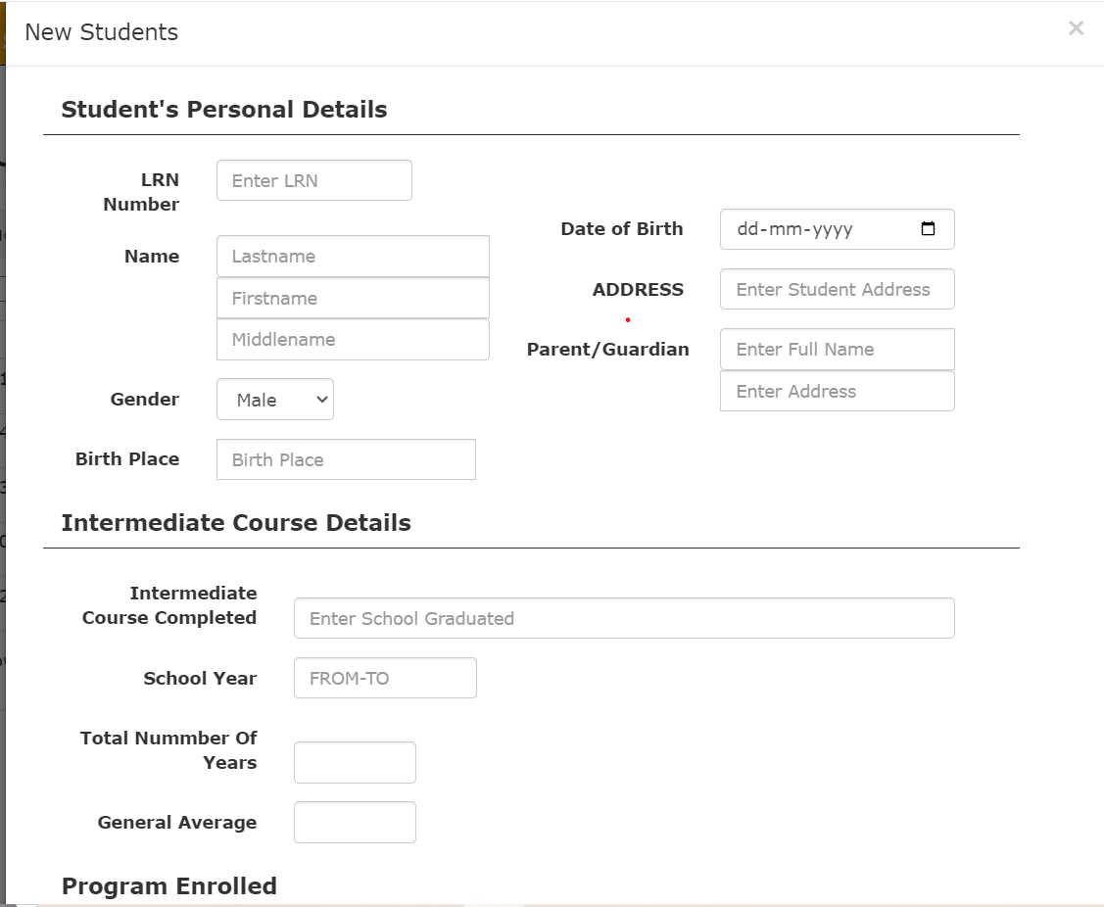
Student Registration

Slide 5

Profile at student
The student profile page provides a comprehensive overview of each student's academic and extracurricular achievements. It serves as a central hub for storing and accessing a student's key information, empowering educators, administrators, and students themselves to stay informed and engaged with their educational journey.
At the top of the profile, a neatly organized header displays the student's name, student ID, grade level, and any relevant academic honors or awards they have earned. This allows for quick identification and a high-level understanding of the student's standing. Beneath the header, a detailed personal section includes the student's contact information, emergency contacts, and demographic data. This ensures that the school has up-to-date and accurate information to support the student's needs.
The profile page also features a robust academic record section, chronicling the student's course history, grades, and test scores. This empowers educators to track the student's progress over time, identify areas for improvement, and provide tailored support. Additionally, the profile showcases the student's extracurricular involvement, highlighting their participation in clubs, sports, and other activities. This well-rounded view of the student's experiences helps administrators and counselors guide the student's personal and professional development.

Slide 6
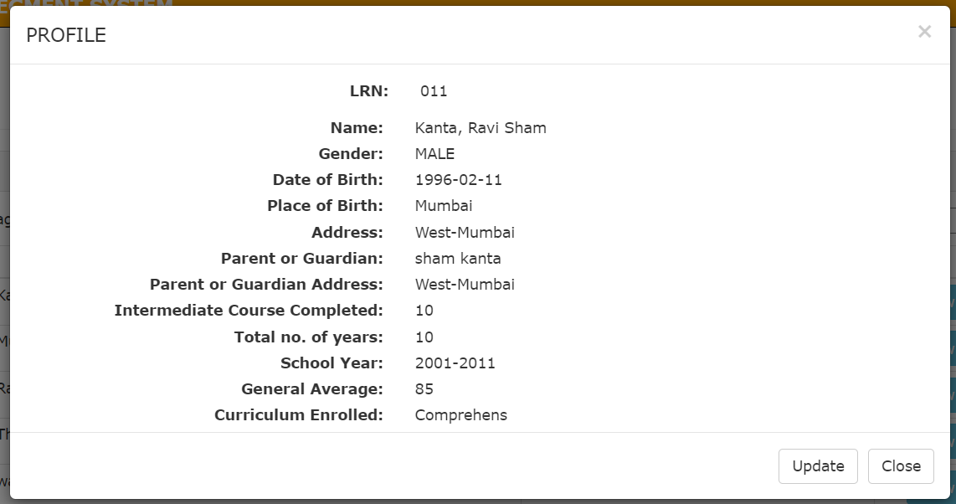
Profile at student

Slide 7
Subjects List
Core Subjects
Elective Subjects
Foreign Languages
Creative Subjects
English
Mathematics
Computer Science
French
Fine Arts
Physics
Spanish
Music
Economics
Mandarin
Drama
Chemistry
Psychology
German
Creative Writing
Biology
Sociology
History

Slide 8
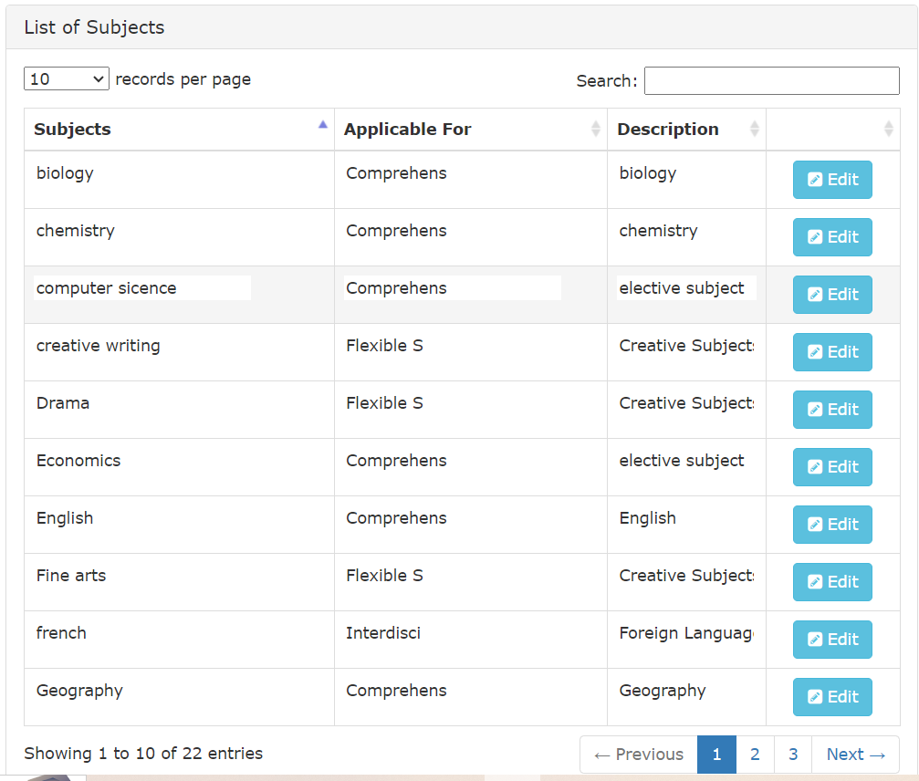
Subjects List

Slide 9
Curriculum list
1
Comprehensive Curriculum
The student grade system offers a comprehensive curriculum that covers a wide range of subjects, from core academic disciplines to electives and specialized courses. This breadth of offerings ensures that students can explore their interests, develop their skills, and prepare for their future academic and career aspirations. The curriculum is designed to be challenging yet engaging, providing students with a well-rounded education that sets them up for success.
2
Flexible Scheduling
The student grade system recognizes that not all students learn at the same pace or have the same schedules. As such, the curriculum offers a flexible scheduling system that allows students to customize their course load and pace of learning. This flexibility enables students to balance their academic responsibilities with extracurricular activities, work commitments, or personal obligations, ensuring that they can achieve their educational goals without feeling overwhelmed.
3
Interdisciplinary Approach
The curriculum in the student grade system is designed to be interdisciplinary, encouraging students to make connections between different subject areas and apply their knowledge in practical, real-world contexts. This approach fosters critical thinking, problem-solving, and collaboration skills, which are highly valued in today's rapidly changing job market. By exposing students to diverse perspectives and ways of thinking, the curriculum prepares them to be adaptable, innovative, and capable of navigating complex challenges.

Slide 10
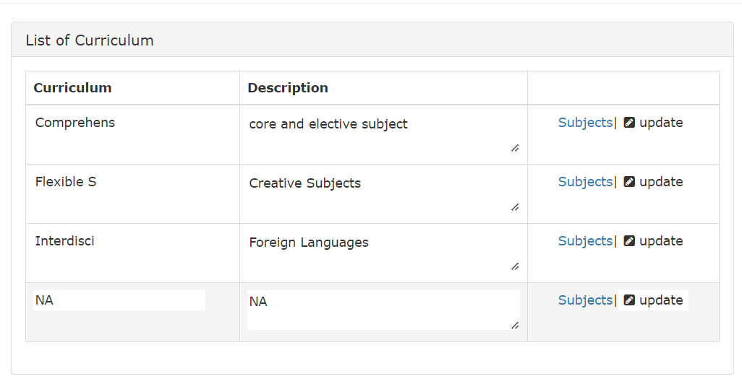
Curriculum list

Slide 11
Academic Record
1
Comprehensive Tracking
2
Percentage-Based Reporting
The student grade system provides a comprehensive way to track and monitor each student's academic performance. It records their grades, test scores, and overall academic progress across different subjects and grade levels. This detailed record allows educators, administrators, and parents to closely follow a student's journey and identify areas for improvement or recognition.
A key feature of the student grade system is its ability to generate percentage-based reports on a student's academic record. This data-driven approach provides a clear, quantifiable measure of a student's performance, making it easy to compare progress over time or against established benchmarks. Administrators and teachers can use these percentage-based reports to make informed decisions about curriculum, teaching methods, and student support services.
3
Trends and Patterns
4
Data-Driven Decision Making
By analyzing the percentage-based academic records, the student grade system can uncover valuable trends and patterns. This information can help identify students who may be struggling in certain subjects, as well as those who are excelling and could benefit from more advanced coursework or enrichment opportunities. The system's ability to track performance over multiple years also allows for the identification of long-term trends, enabling proactive interventions and targeted support for students.
The comprehensive academic records and percentage-based reporting provided by the student grade system empower administrators, teachers, and parents to make data-driven decisions. This information can inform curriculum development, resource allocation, and the implementation of tailored support programs. By leveraging the insights gained from the system, schools can optimize their educational offerings and ensure that each student receives the personalized attention and resources they need to succeed.

Slide 12
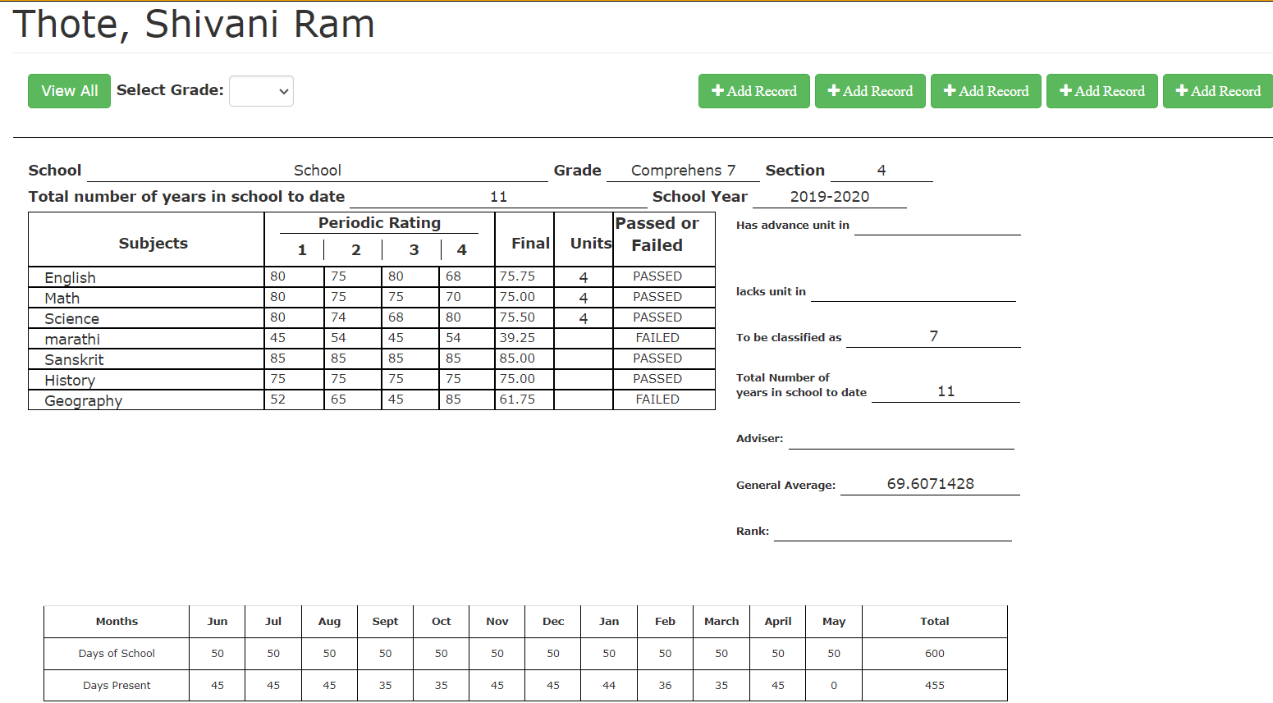
Academic Record

Slide 13



Promoted Students Candidates
Academic Performance
Continuous Improvement
Achievements
The list of promoted students is carefully curated based on their academic performance throughout the year. These students have demonstrated excellence in their studies, consistently achieving high grades and showing a strong commitment to their education. Their academic records reflect their dedication and hard work, making them well-deserving of the promotion to the next grade level.
In addition to their academic prowess, many of the promoted students have also excelled in extracurricular activities, community service, or leadership roles. These well-rounded accomplishments further solidify their readiness for advancement and demonstrate their ability to balance academic responsibilities with personal growth and community engagement.
The promotion of these students is a testament to their continuous growth and improvement. They have not only maintained high academic standards but have also shown a willingness to learn, adapt, and take on new challenges. This progression is a crucial aspect of their development, as it prepares them for the demands of the next grade and sets them up for long-term success.

Slide 14
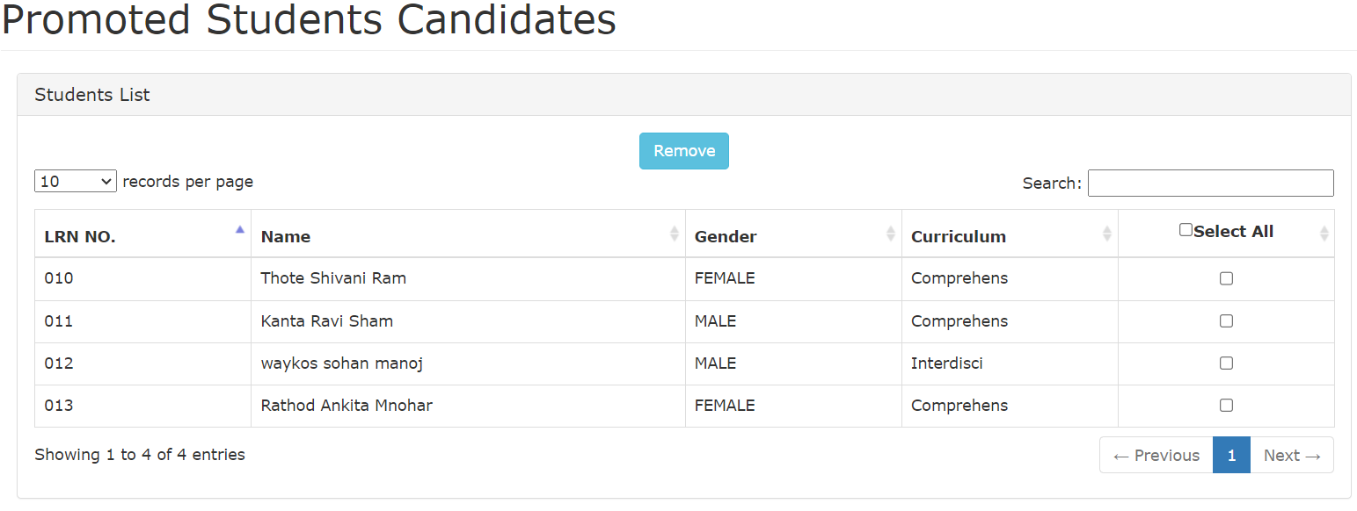
Promoted Students Candidates

Slide 15
Reports student records
The student records report is a comprehensive tool that allows administrators and educators to access and analyze detailed information about each student's academic performance and progress. This report consolidates data from various sources, including student registration, grade submissions, attendance records, and any disciplinary actions, to provide a holistic view of a student's educational journey.
The report is typically organized in a tabular format, with rows representing individual students and columns displaying key data points such as student ID, name, grade level, cumulative GPA, class attendance, and any notable achievements or behavioral concerns. This structured layout makes it easy to quickly identify patterns, trends, and outliers within the student population.
Student ID
Name
Grade Level
Cumulative GPA
Attendance
Achievements
Behavioral Concerns
12345
Samantha Johnson
11th
3.8
95%
Honor Roll, Science Fair Winner
None
67890
Michael Lee
12th
3.2
85%
Student Council Vice President
Occasional tardiness
24680
Emily Garcia
10th
4.0
92%
National Merit Scholar
None
The student records report serves as a valuable tool for administrators and educators to identify students who may require additional support, monitor the overall academic performance of the institution, and make informed decisions regarding curriculum, resource allocation, and student interventions. By providing a comprehensive and organized view of student data, this report enables school leaders to effectively track and address the needs of each individual student, ultimately contributing to their academic success and personal growth.

Slide 16
Student List Report
The student list report is a comprehensive overview of all the students enrolled in the school's academic programs. This report serves as a valuable resource for administrators, teachers, and counselors, providing a detailed snapshot of the student population and their academic standing.
215
80
135
Total Students
Female Students
Male Students
The school currently has 3,215 students enrolled across all grade levels, representing a diverse range of academic abilities and backgrounds.
Of the total student population, 1,450 are female, highlighting the school's commitment to gender diversity and equal educational opportunities.
The remaining 1,765 students are male, demonstrating the balanced gender representation within the school.
The student list report also provides a breakdown of students by grade level, with detailed information on their academic progress, attendance records, and extracurricular involvement. This data is invaluable for identifying areas of strength, as well as opportunities for improvement, allowing administrators and educators to tailor their strategies and allocate resources more effectively.
Moreover, the report includes information on student demographics, such as socioeconomic status, ethnicity, and special education needs. This comprehensive data set enables the school to develop targeted support programs and ensure that all students have access to the resources and support they require to succeed academically.
Overall, the student list report is a crucial tool for managing and monitoring the school's student population, informing decision-making processes, and driving continuous improvement in the quality of education provided.

